Slide 1


MULTIVARIATE ANALYSIS
MULTIPLE REGRESSION
Data and Business Analytics
S T A T I S T I C S & P R O B A B I L I T Y F O R D A T A A N A L Y S I S A N D M A N A G E M E N T
Manoel Gadi, Ph.D.
2025

Slide 2
Categorical Variable
df[var].value_counts(normalize=True)
Chi-Square Test
Exploratory Data Analysis
Unbiased variable with Normal Distribution
Any of this can prove normality: Shapiro, KS, Jarque-Bera and Histogram
Use mean (parametric test)
T-test
ANOVA test if 3+ groups
Numerical
Variable
df[var].describe()
Capped discrete, very skewed or with no Normal Distribution
Use median (non-parametric test)
Mann–Whitney test
Kruskal Wallis if 3+ groups and non-parametric

Slide 3
Look the data
Not enough columns or rows
(univariate and bivariate analysis only)
Yes, enough columns or rows
(multivariate analysis, too much work to do it by hand)
Multivariate Methods
They will help us
No target variable (no label data) no column informing what needs to be predicted
Yes, target variable (labelled data) there is a column informing what needs to be predicted
Unsupervised
Supervised
#colums * 20 > # rows
Or Multicollinearity /Correlation/Causality
Target continuous
Target Binary / Categorical
#colums * 20 < # rows
EDA
PCA
Cluster
Regression
Classification
(-) Worse models/inference
(+) Better models/inference

Slide 4



Dependence Tests ….
Dependence Techniques
Multiple regression
Multiple Discriminant analysis
Logistic regression
Analyze the relationship between a single dependent (criterion) variable and several independent (predictor) variables

Slide 5
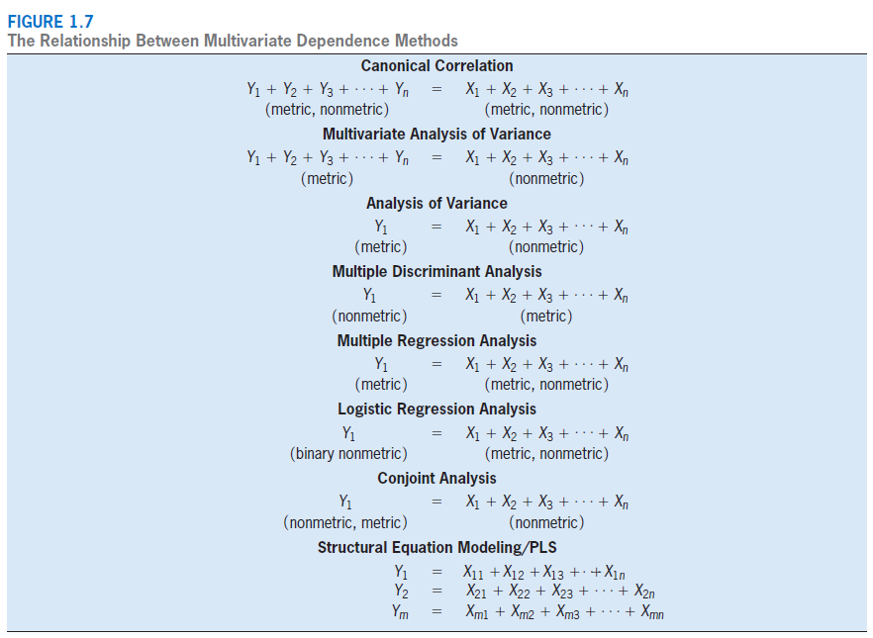

Slide 6
Multivariate Regression: The Variate
A variate value (Y’) is calculated for each respondent.
Y’ = b₀ + b₁X₁ + b₂X₂ + . . . + b_{n}X_{n} + e
The Y’ value is a linear combination of the entire set of variables that best achieves the statistical objective.
Y = Dependent Variable = # of credit cards
b₀ = intercept (constant) = constant number of credit
X₃
cards independent of family size and income.
b₁ = change in # of credit cards associated with a unit change in family size (regression coefficient).
b = change in # of credit cards associated with a unit change in income (regression coefficient).
X₁ = family size X₂ = income
e = prediction error (residual)
Y’
X₁
2
X₂

Slide 7
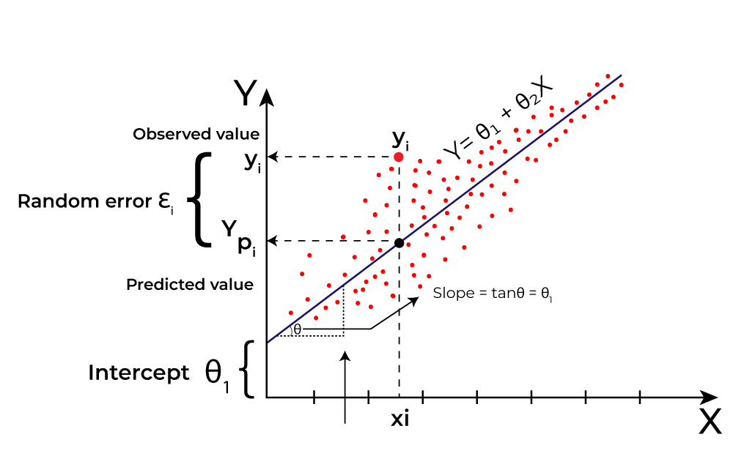

Slide 8

Ejercicio
Definición de los datos para la construcción de modelos para el análisis multivariado.
Objetivo de aprendizaje: esta actividad tiene como objetivo probar su capacidad para definir cada paso dentro de un modelo multivariado e identificar los principales problemas dentro de cada paso.
Se le pide que diga cuántos coches en movimiento hay en una calle de 2 sentidos de 1 km de largo en este momento. No tienes imágenes satelitales, lo único que tienes es una moto para recorrer la calle y contar los carros. No se puede dar un número exacto de autos porque todos los autos se están moviendo, por lo que su trabajo es dar su mejor estimación. Defina cómo recolectaría los datos (usando la motocicleta, puede viajar por la calle 0 veces, en 1 sentido o en ambos sentidos o muchas veces) y luego defina cada etapa del esquema del modelo a continuación y analice una o dos de sus principales limitaciones (para cada etapa).
Fill: https://github.com/manoelgadi/Peppermoney/blob/main/Template_Activity%203.2-MODEL%20BUILDING_V2.pptx

Slide 9
ACTIVITY 3.2 – A SIX-STAGE APPROACH TO MULTIVARIABLE MODEL BUILDING
Stage 1. Objectives
Stage 2. Analysis Plan / Design
Stage 3. Assumptions
LIMITATIONS
LIMITATIONS
LIMITATIONS
Stage 6. Validation
Stage 5. Model Interpretation: statistical vs practical significance
(For activity 3.2 leave this part blank)
Stage 4. Model Building: Parameter's estimation
LIMITATIONS
LIMITATIONS
(For activity 3.2 leave this part blank)
LIMITATIONS
9

Slide 10
ACTIVITY 3.2 – A SIX-STAGE APPROACH TO MULTIVARIABLE MODEL BUILDING
Stage 1. Objectives
Stage 2. Analysis Plan / Design
Stand at the end of 1st way, count the number of cars
passing by for X minutes (Depending on speed limit of the street if 30km/h = 30km/60min = 1km/2min), multiply number by 2 and store the number in a list, in a second list store the time (month-day-hour-minute- dayofweek), in a third list to store the weather condition (sunny, rainy, snowy…), in a 4th list the number of lanes in that street, repeat the process for the 2nd way until our lists has 30 inputs(15 in each way). Repeat this process for 10 days in a different 1km 2 way street each day. (end sample = 300)
Stage 3. Assumptions
Sum of number of cars moving in a 1km 2 way street live
Cars are not allowed overtaking,
Random distribution of cars, Cars are all going at the speed limit,
The two ways of a street
have the same number of cars
LIMITATIONS
Measurement is an estimation that will lack accuracy
LIMITATIONS
Special events/holydays, Population specific characteristics
LIMITATIONS
Assumptions are not always ensured in real life scenarios
Stage 6. Validation
Stage 5. Model Interpretation: statistical vs practical significance
Stage 4. Model Building: Parameter's estimation
The model is a Regression: y = b0 + b1*x1
+ b2*x2 + …. + b7*x7
b0 will be the average of the first list
x1, x2, x3, x4, x5 will be minute, hour, day, month, day of week
x6 will be the number of lanes in the street
x7 will be a categorical variable representing the weather condition
y is the prediction for number of moving cars
Cross-validation by splitting the data on the basis of the different streets (10 streets total)
(For activity 3.2 leave this part blank)
LIMITATIONS
Some of the inputs recorded might be false due to human error
LIMITATIONS
(For activity 3.2 leave this part blank)
LIMITATIONS
Some of the inputs recorded might be false due to human error
1

Slide 11
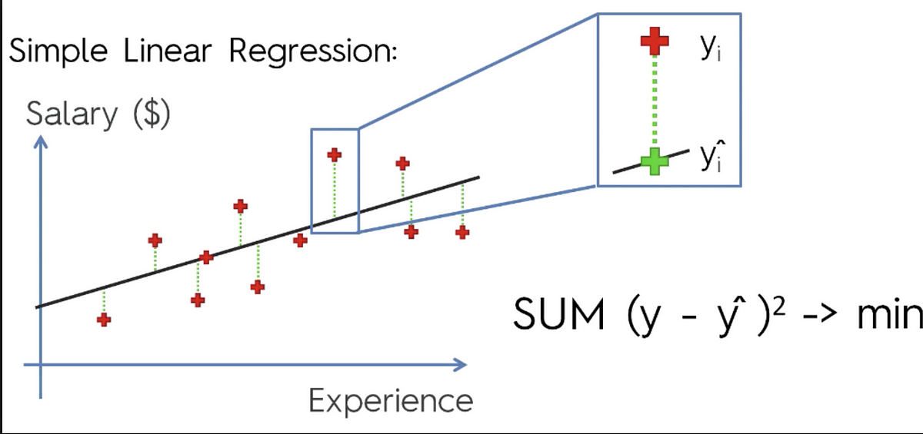
Stage 4

Slide 12
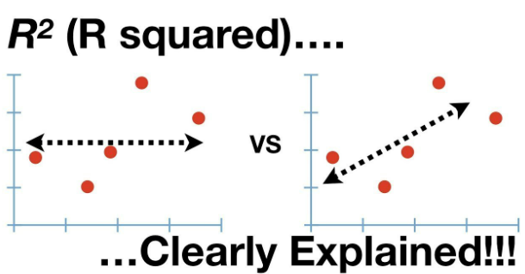
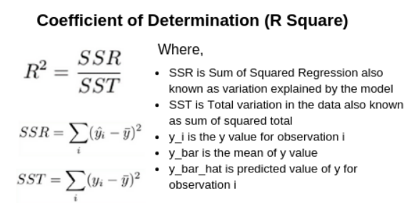

Slide 13
ACTIVITY 2 – SIX-STAGE APPROACH TO MULTIVARIABLE MODEL BUILDING FOR LINEAR REGRESSION ANALYSIS
Stage 1. Objectives
Stage 2. Analysis Plan / Design
Stage 3. Assumptions
LIMITATIONS
LIMITATIONS
LIMITATIONS
Stage 6. Validation
Stage 5. Model Interpretation: statistical vs practical significance
.
Stage 4. Model Building: Parameter's estimation
LIMITATIONS
LIMITATIONS
.
LIMITATIONS
13

Slide 14
SIX-STAGE APPROACH TO MULTIVARIABLE MODEL BUILDING FOR LINEAR REGRESSION ANALYSIS
Stage 1. Objectives
Multiple Regression Analysis: target exists and is only one.
Y₁ = X₁ + X₂ + X₃ + ... + Xₙ
(metric) = (metric, nonmetric)
Stage 2. Analysis Plan / Design
Must scale each x in X (standard scale or min-max scale)
No missing values (apply remedies)
Outliers (Remove or Flag)
Dummy variable all Categorical Nominal or Ordinal variables
Sample size: minimum 20 with 5 rows to column. Recommend: 50 with 20 rows to column.
Stage 3. Assumptions
Linearity (between x ~ y)
Normality (each x)
Homoscedasticity (y ~ y_pred)
No Multicollinearity (X)
Independence (rows of X) - no autocorrelation
LIMITATIONS
Cannot be used for multiple targets, unsupervised learning or categorical target
LIMITATIONS
Should not be used if data does meet minimum standards or transformation and remedies cannot be applied.
LIMITATIONS
Remedies should be applied if assumptions not met
Remedies to multicollinearity: Lasso, Ridge or Bayesian / Regression on Principal Components
Stage 6. Validation
Sum of Squared Errors
Mean Squared Errors
R squared (R²)
Adjusted R squared (R²)
No drop higher than 10% I
n performance between train and test or cross-validation samples
Stage 5. Model Interpretation: statistical vs practical significance
Interpret coefficients
p-value < 5% (t-test – H0: coef = 0) - > Drop Feature
R-squared ( < 50% weak / > 90% overfitting?)
Stage 4. Model Building: Parameter's estimation
Goodness of fit (F-statistic)
Feature Selection (Confirmatory / Sequential / Combinatorial / Optimization)
LIMITATIONS
Population Drift
Relationship Drift
Slow Speed
LIMITATIONS
Not enough data, tests wrongly fail.
Too much data, tests invalid, wrongly always significant .
LIMITATIONS
Over-fitting: The model might leads to poor performance on new, unseen data.
Extrapolation for unknow ranges

Slide 15
Look the data
Not enough columns or rows
(univariate and bivariate analysis only)
Yes, enough columns or rows
(multivariate analysis, too much work to do it by hand)
Multivariate Methods
They will help us
No target variable (no label data) no column informing what needs to be predicted
Yes, target variable (labelled data) there is a column informing what needs to be predicted
Unsupervised
Supervised
#colums * 20 > # rows
Or Multicollinearity /Correlation/Causality
Target continuous
Target Binary / Categorical
#colums * 20 < # rows
EDA
PCA
Cluster
Regression
Classification
(-) Worse models/inference
(+) Better models/inference

Slide 16
Categorical Variable
df[var].value_counts(normalize=True)
Chi-Square Test
Exploratory Data Analysis
Unbiased variable with Normal Distribution
Any of this can prove normality: Shapiro, KS, Jarque-Bera and Histogram
Use mean (parametric test)
T-test
ANOVA test if 3+ groups
Numerical
Variable
df[var].describe()
Capped discrete, very skewed or with no Normal Distribution
Use median (non-parametric test)
Mann–Whitney test
Kruskal Wallis if 3+ groups and non-parametric

Slide 17
References
Objectives | Design | Assumptions | Model | Interpretation | Validation
Joseph, F. Hair Jr, William C. Black, Barry J. Babin & Ralph E. Anderson. Multivariate Data Analysis. Pearson. 7th edition. Chapter 4.

